Slide 1
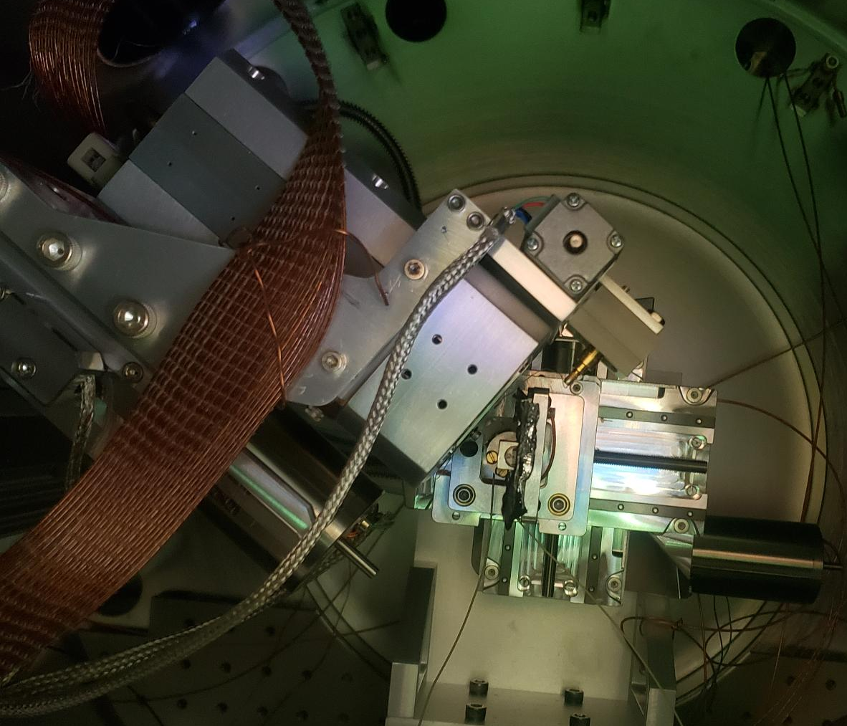
Rotated and Tilted CCD: Geometry and Solid Angle Corrections for 2D to 1D Data Reduction
By: Devin Grabner, Washington State University
Notes:
The next Micelle I am working with.

Slide 2
Conclusion:
Only 1 new input needs added to the ‘2D to 1D Data Conversion Panel’ to make all this added functionality work seamlessly in NIKA.
The default for the new input can be set to zero.
New input:
The distance from the axis of rotation of the CCD to the sample. (‘d1’ in the code)

Slide 3
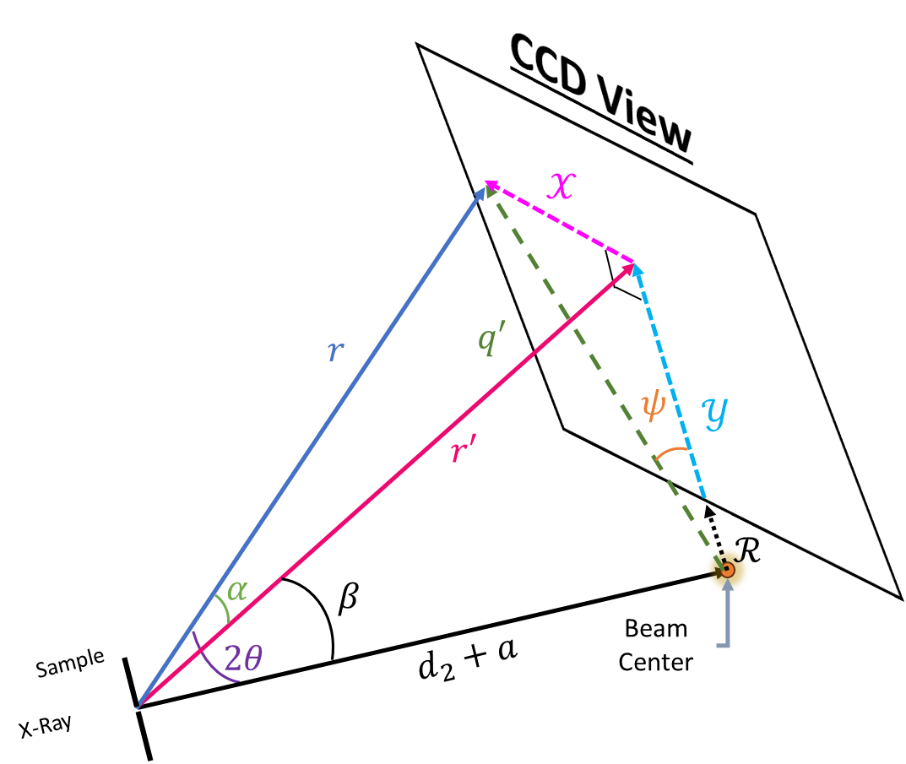
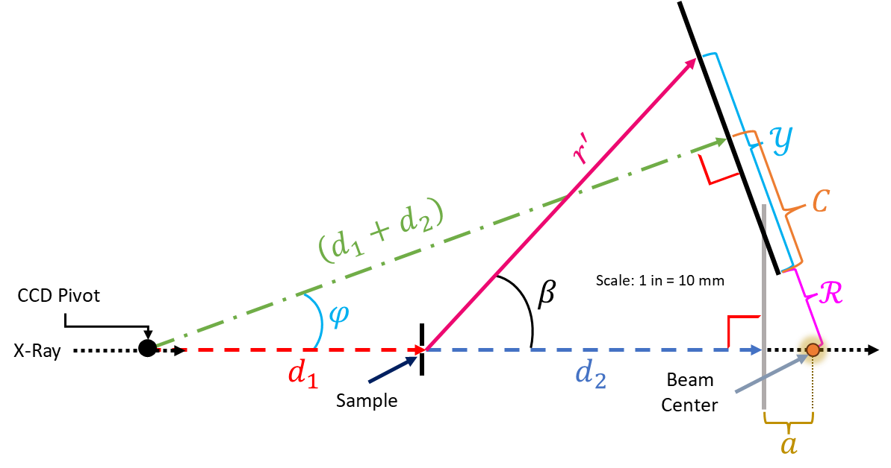
Geometry & Solid Angle Corrections for Rotated and Tilted CCD
Rotated CCD
CCD at normal incidence

Slide 4
This presentation details the how the scattering geometry is calculated. Resulting in 7 needed inputs to compute the ‘q’ value of a given pixel on the CCD. I also go over the calculations for the Solid Angle (SA) corrections also necessary for these extreme geometry measurements.
After I establish the mathematics behind the two corrections, I will go show examples of the resulting ‘q map’ and SA correction map. I will also show log binned histograms of the number of pixels on the CCD associated with a q range.
At the end I will show how this is being implemented into NIKA and the minor adjustments needed to make it a permanent feature.

Slide 5

Geometry Correction
The next 5 slides is all the math relating the scattering geometry to directly measurable quantities associated with the experimental set up.
If you would like to skip the details and jump to a summary, click here $⇒$ SUMMARY

Slide 6


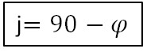


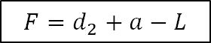


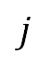
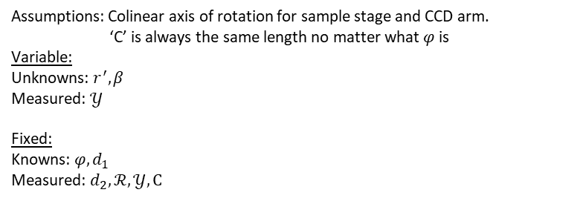
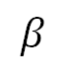
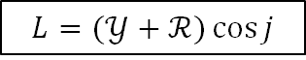

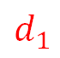
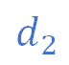
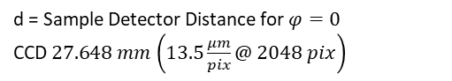
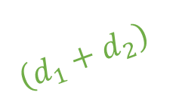
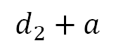
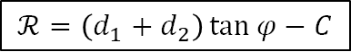

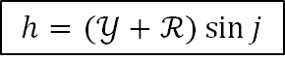
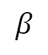


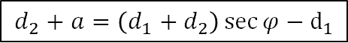
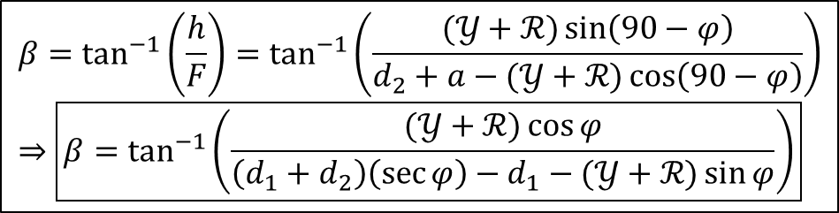
j$=90−φ$
$$h=(𝒴+ℛ)\sin{j}$$
$$r^{′}={\left[{\left(d_{2}+a−(𝒴+ℛ)\cos{j}\right)}^{2}+{\left((𝒴+ℛ)\sin{j}\right)}^{2}\right]}^{\frac{1}{2}}$$
$$F=d_{2}+a−L$$
$$L=(𝒴+ℛ)\cos{j}$$
$$d_{2}+a=\left(d_{1}+d_{2}\right)\sec{φ}−d_{1}$$
$$β=\tan^{−1}\left(\frac{h}{F}\right)=\tan^{−1}\left(\frac{(𝒴+ℛ)\sin\left(90−φ\right)}{d_{2}+a−(𝒴+ℛ)\cos\left(90−φ\right)}\right)⇒\boxed{β=\tan^{−1}\left(\frac{(𝒴+ℛ)\cos{φ}}{\left(d_{1}+d_{2}\right)\left(\sec{φ}\right)−d_{1}−(𝒴+ℛ)\sin{φ}}\right)}$$
$$r′$$
$$𝒴$$
$$h$$
$$β$$
$$ℛ$$
$$j$$
$$ℛ=\left(d_{1}+d_{2}\right)\tan{φ}−C$$
Side View
$$r^{′}$$
$$𝒴$$
$$d_{2}+a$$
F
L
$$C$$
Assumptions: Colinear axis of rotation for sample stage and CCD arm. ‘C’ is always the same length no matter what $φ$ is
Variable:
Unknowns: $r^{′}, β$
Measured: $𝒴$
Fixed:
Knowns: $φ, d_{1}$ Measured: $d_{2}, ℛ, 𝒴,C$
$\left(d_{1}+d_{2}\right)$
CCD Pivot
$$β$$
Scale: 1 in = 10 mm
$$ℛ$$
$$φ$$
X-Ray
$$d_{1}$$
$$d_{2}$$
Beam Center
Sample
d = Sample Detector Distance for $φ=0$ CCD$27.648 mm$ $\left(13.5\frac{μm}{pix}@ 2048 pix\right)$
$$a$$

Slide 7

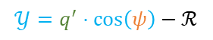

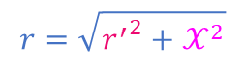
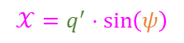
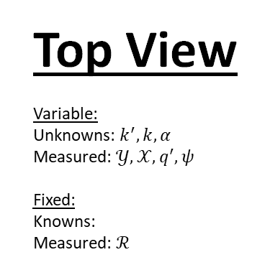



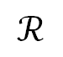
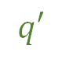


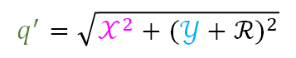
Top View
Variable:
Unknowns: $k^{′}, k,α$
Measured: $𝒴,𝒳,q^{′},ψ$
Fixed:
Knowns: Measured: $ℛ$
$$𝒳$$
CCD View
$$𝒳=q^{′}⋅\sin\left(ψ\right)$$
$$𝒴=q^{′}⋅\cos\left(ψ\right)−ℛ$$
$$𝒳$$
$$r=\sqrt{{r^{′}}^{2}+𝒳^{2}}$$
$$r$$
Beam Center
$$r^{′}$$
$$q′$$
$$𝒴$$
$$α$$
$$ψ$$
$$ℛ$$
Sample
Scale: 1 in = 5 mm
$$q^{′}=\sqrt{𝒳^{2}+{(𝒴+ℛ)}^{2}}$$

Slide 8
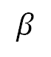

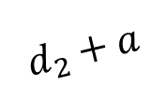



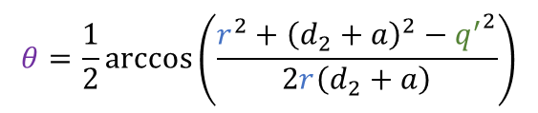




$${q^{′}}^{2}=r^{2}+{\left(d_{2}+a\right)}^{2}−2r\left(d_{2}+a\right)\cos\left(2θ\right)$$
CCD View
$$r$$
$$𝒳$$
$$q′$$
Scattering Angle
$$q′$$
$$2θ$$
$$r$$
$$ψ$$
$$𝒴$$
$$d_{2}+a$$
$$r′$$
Beam Center
$$θ=\frac{1}{2}\arccos\left(\frac{r^{2}+{\left(d_{2}+a\right)}^{2}−{q^{′}}^{2}}{2r\left(d_{2}+a\right)}\right)$$
$$ℛ$$
$$α$$
$$β$$
Sample
$$2θ$$
$$d_{2}+a$$
X-Ray

Slide 9
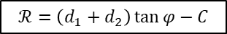
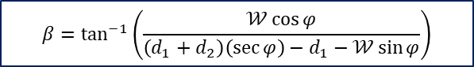
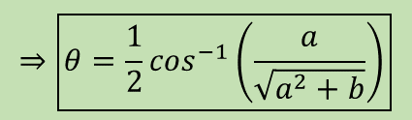
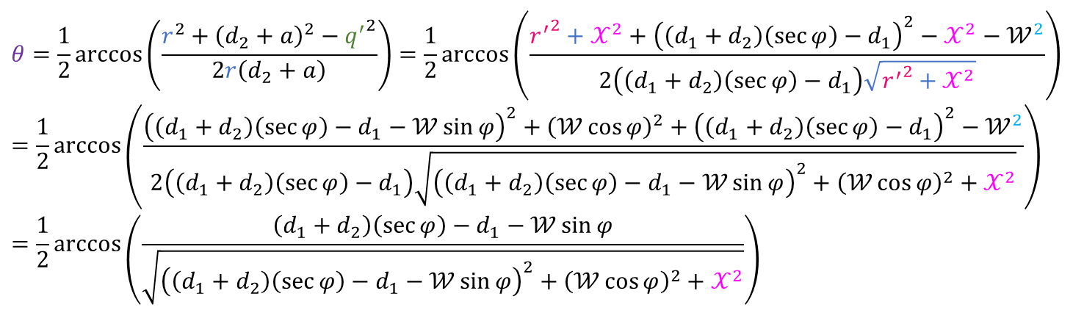
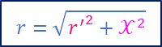
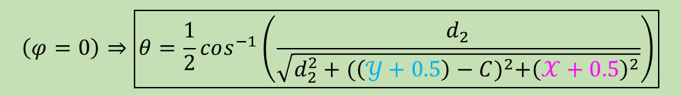

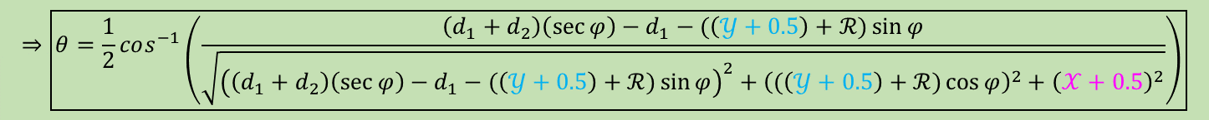
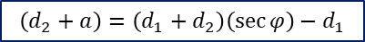
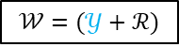
$$\left(d_{2}+a\right)=\left(d_{1}+d_{2}\right)\left(\sec{φ}\right)−d_{1}$$
$$𝒲=(𝒴+ℛ)$$
$$r=\sqrt{{r^{′}}^{2}+𝒳^{2}}$$
$$β=\tan^{−1}\left(\frac{𝒲\cos{φ}}{\left(d_{1}+d_{2}\right)\left(\sec{φ}\right)−d_{1}−𝒲\sin{φ}}\right)$$
$$r^{′}={\left[{\left(d_{2}+a−𝒲\sin{φ}\right)}^{2}+{\left(𝒲\cos{φ}\right)}^{2}\right]}^{\frac{1}{2}}$$
$$q^{′}=\sqrt{𝒳^{2}+𝒲^{2}}$$
$$ℛ=\left(d_{1}+d_{2}\right)\tan{φ}−C$$
$$θ=\frac{1}{2}\arccos\left(\frac{r^{2}+{\left(d_{2}+a\right)}^{2}−{q^{′}}^{2}}{2r\left(d_{2}+a\right)}\right)=\frac{1}{2}\arccos\left(\frac{{r^{′}}^{2}+𝒳^{2}+{\left(\left(d_{1}+d_{2}\right)\left(\sec{φ}\right)−d_{1}\right)}^{2}−𝒳^{2}−𝒲^{2}}{2\left(\left(d_{1}+d_{2}\right)\left(\sec{φ}\right)−d_{1}\right)\sqrt{{r^{′}}^{2}+𝒳^{2}}}\right)=\frac{1}{2}\arccos\left(\frac{{\left(\left(d_{1}+d_{2}\right)\left(\sec{φ}\right)−d_{1}−𝒲\sin{φ}\right)}^{2}+{\left(𝒲\cos{φ}\right)}^{2}+{\left(\left(d_{1}+d_{2}\right)\left(\sec{φ}\right)−d_{1}\right)}^{2}−𝒲^{2}}{2\left(\left(d_{1}+d_{2}\right)\left(\sec{φ}\right)−d_{1}\right)\sqrt{{\left(\left(d_{1}+d_{2}\right)\left(\sec{φ}\right)−d_{1}−𝒲\sin{φ}\right)}^{2}+{\left(𝒲\cos{φ}\right)}^{2}+𝒳^{2}}}\right)=\frac{1}{2}\arccos\left(\frac{\left(d_{1}+d_{2}\right)\left(\sec{φ}\right)−d_{1}−𝒲\sin{φ}}{\sqrt{{\left(\left(d_{1}+d_{2}\right)\left(\sec{φ}\right)−d_{1}−𝒲\sin{φ}\right)}^{2}+{\left(𝒲\cos{φ}\right)}^{2}+𝒳^{2}}}\right)$$
$$⇒\boxed{θ=\frac{1}{2}cos^{−1}\left(\frac{\left(d_{1}+d_{2}\right)\left(\sec{φ}\right)−d_{1}−(\left(𝒴+0.5\right)+ℛ)\sin{φ}}{\sqrt{{\left(\left(d_{1}+d_{2}\right)\left(\sec{φ}\right)−d_{1}−(\left(𝒴+0.5\right)+ℛ)\sin{φ}\right)}^{2}+{\left((\left(𝒴+0.5\right)+ℛ)\cos{φ}\right)}^{2}+{\left(𝒳+0.5\right)}^{2}}}\right)}$$
$$⇒\boxed{θ=\frac{1}{2}cos^{−1}\left(\frac{a}{\sqrt{a^{2}+b}}\right)}$$
$$\left(φ=0\right)⇒\boxed{θ=\frac{1}{2}cos^{−1}\left(\frac{d_{2}}{\sqrt{d_{2}^{2}+{(\left(𝒴+0.5\right)−C)}^{2}+{\left(𝒳+0.5\right)}^{2}}}\right)}$$

Slide 10
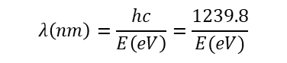
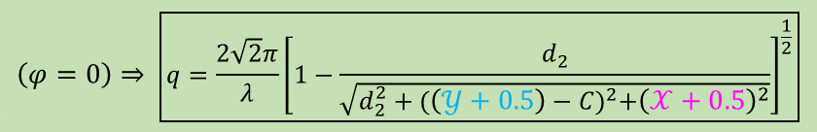
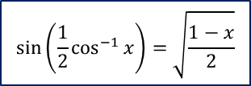
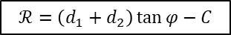
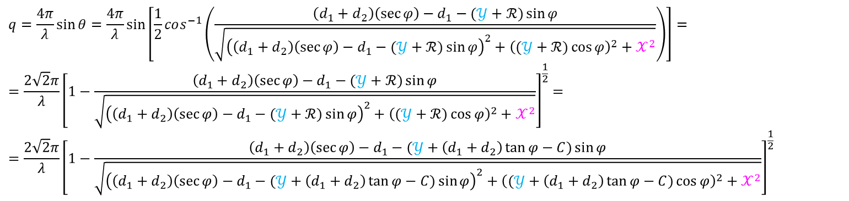
$$ℛ=\left(d_{1}+d_{2}\right)\tan{φ}−C$$
$$q=\frac{4π}{λ}\sin{θ}=\frac{4π}{λ}\sin\left[\frac{1}{2}cos^{−1}\left(\frac{\left(d_{1}+d_{2}\right)\left(\sec{φ}\right)−d_{1}−(𝒴+ℛ)\sin{φ}}{\sqrt{{\left(\left(d_{1}+d_{2}\right)\left(\sec{φ}\right)−d_{1}−(𝒴+ℛ)\sin{φ}\right)}^{2}+{\left((𝒴+ℛ)\cos{φ}\right)}^{2}+𝒳^{2}}}\right)\right]==\frac{2\sqrt{2}π}{λ}{\left[1−\frac{\left(d_{1}+d_{2}\right)\left(\sec{φ}\right)−d_{1}−(𝒴+ℛ)\sin{φ}}{\sqrt{{\left(\left(d_{1}+d_{2}\right)\left(\sec{φ}\right)−d_{1}−(𝒴+ℛ)\sin{φ}\right)}^{2}+{\left((𝒴+ℛ)\cos{φ}\right)}^{2}+𝒳^{2}}}\right]}^{\frac{1}{2}}==\frac{2\sqrt{2}π}{λ}{\left[1−\frac{\left(d_{1}+d_{2}\right)\left(\sec{φ}\right)−d_{1}−(𝒴+\left(d_{1}+d_{2}\right)\tan{φ}−C)\sin{φ}}{\sqrt{{\left(\left(d_{1}+d_{2}\right)\left(\sec{φ}\right)−d_{1}−(𝒴+\left(d_{1}+d_{2}\right)\tan{φ}−C)\sin{φ}\right)}^{2}+{\left((𝒴+\left(d_{1}+d_{2}\right)\tan{φ}−C)\cos{φ}\right)}^{2}+𝒳^{2}}}\right]}^{\frac{1}{2}}$$
$$\boxed{q=\frac{2\sqrt{2}π}{λ}{\left[1−\frac{\left(d_{1}+d_{2}\right)\left(\sec{φ}\right)−d_{1}−(\left(𝒴+0.5\right)+\left(d_{1}+d_{2}\right)\tan{φ}−C)\sin{φ}}{\sqrt{{\left(\left(d_{1}+d_{2}\right)\left(\sec{φ}\right)−d_{1}−(\left(𝒴+0.5\right)+\left(d_{1}+d_{2}\right)\tan{φ}−C)\sin{φ}\right)}^{2}+{\left((\left(𝒴+0.5\right)+\left(d_{1}+d_{2}\right)\tan{φ}−C)\cos{φ}\right)}^{2}+{\left(𝒳+0.5\right)}^{2}}}\right]}^{\frac{1}{2}}}$$
$$IGOR substituted variables \boxed{q=\frac{2\sqrt{2}π}{λ}{\left[1−\frac{a}{\sqrt{a^{2}+b}}\right]}^{\frac{1}{2}}}$$
$$\left(φ=0\right)⇒ \boxed{q=\frac{2\sqrt{2}π}{λ}{\left[1−\frac{d_{2}}{\sqrt{d_{2}^{2}+{(\left(𝒴+0.5\right)−C)}^{2}+{\left(𝒳+0.5\right)}^{2}}}\right]}^{\frac{1}{2}}}$$
$$\sin\left(\frac{1}{2}\cos^{−1}{x}\right)=\sqrt{\frac{1−x}{2}}$$
$$λ\left(nm\right)=\frac{hc}{E\left(eV\right)}=\frac{1239.8}{E(eV)}$$

Slide 11

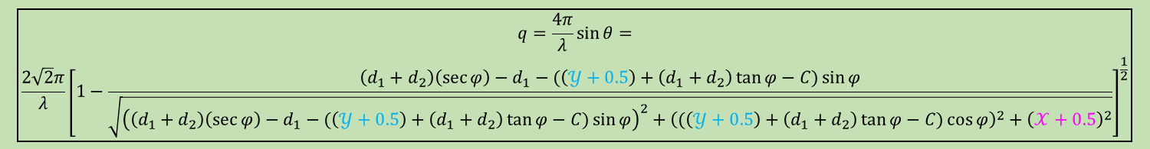
$$\boxed{θ=\frac{1}{2}cos^{−1}\left(\frac{\left(d_{1}+d_{2}\right)\left(\sec{φ}\right)−d_{1}−(\left(𝒴+0.5\right)+ℛ)\sin{φ}}{\sqrt{{\left(\left(d_{1}+d_{2}\right)\left(\sec{φ}\right)−d_{1}−(\left(𝒴+0.5\right)+ℛ)\sin{φ}\right)}^{2}+{\left((\left(𝒴+0.5\right)+ℛ)\cos{φ}\right)}^{2}+{\left(𝒳+0.5\right)}^{2}}}\right)}$$
$$\boxed{\begin{aligned}q=\frac{4π}{λ}\sin{θ}= \\ \frac{2\sqrt{2}π}{λ}{\left[1−\frac{\left(d_{1}+d_{2}\right)\left(\sec{φ}\right)−d_{1}−(\left(𝒴+0.5\right)+\left(d_{1}+d_{2}\right)\tan{φ}−C)\sin{φ}}{\sqrt{{\left(\left(d_{1}+d_{2}\right)\left(\sec{φ}\right)−d_{1}−(\left(𝒴+0.5\right)+\left(d_{1}+d_{2}\right)\tan{φ}−C)\sin{φ}\right)}^{2}+{\left((\left(𝒴+0.5\right)+\left(d_{1}+d_{2}\right)\tan{φ}−C)\cos{φ}\right)}^{2}+{\left(𝒳+0.5\right)}^{2}}}\right]}^{\frac{1}{2}}\end{aligned}}$$
$$IGOR substituted variables: \boxed{θ=\frac{1}{2}cos^{−1}\left(\frac{a}{\sqrt{a^{2}+b}}\right) \& q=\frac{2\sqrt{2}π}{λ}{\left[1−\frac{a}{\sqrt{a^{2}+b}}\right]}^{\frac{1}{2}}}$$

Slide 12
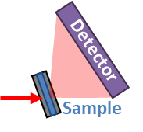
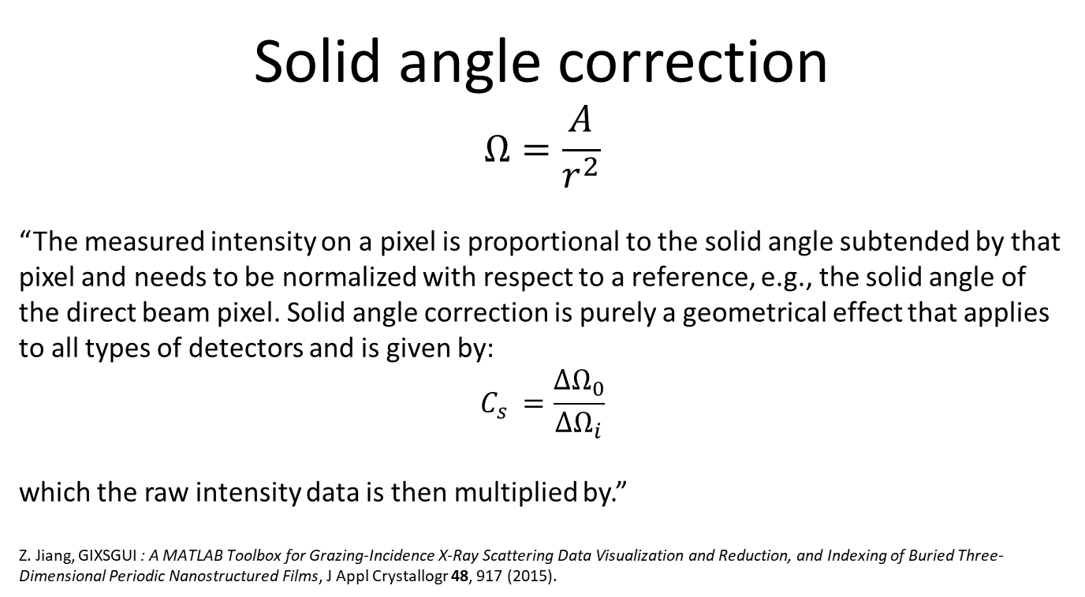
Solid angle correction
$$Ω=\frac{A}{r^{2}}$$
“The measured intensity on a pixel is proportional to the solid angle subtended by that pixel and needs to be normalized with respect to a reference, e.g., the solid angle of the direct beam pixel. Solid angle correction is purely a geometrical effect that applies to all types of detectors and is given by:
$$C_{s} =\frac{∆Ω_{0}}{∆Ω_{i}}$$
which the raw intensity data is then multiplied by.”
Z. Jiang, GIXSGUI : A MATLAB Toolbox for Grazing-Incidence X-Ray Scattering Data Visualization and Reduction, and Indexing of Buried Three-Dimensional Periodic Nanostructured Films, J Appl Crystallogr 48, 917 (2015).
In our case it is not the ‘direct beam’ pixel but the actual pixel or ghost pixel, who’s incident scattering vector is both normal to the Cartesian plane of the CCD and intersects the sample.
At CCD Theta = 0, that pixel is the ‘direct beam’ pixel.

Slide 13
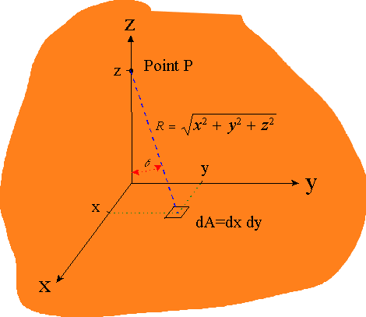
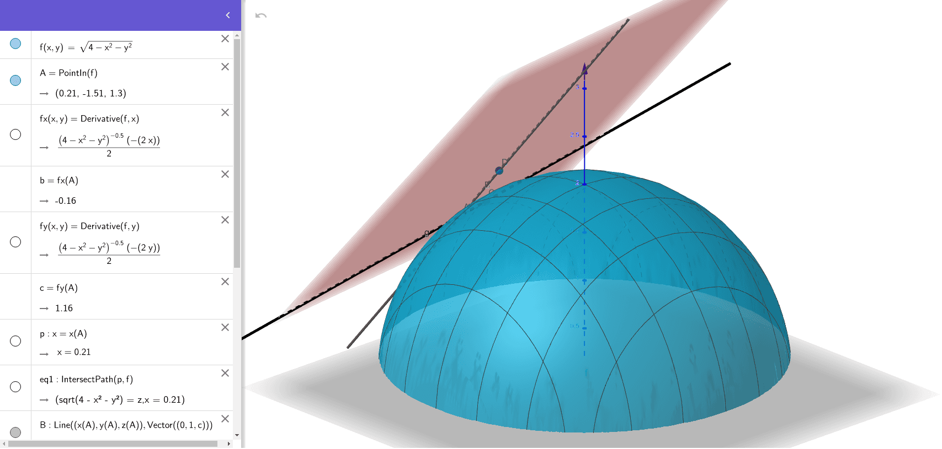
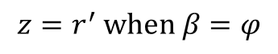
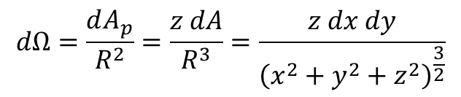



$$z=r^{′} \text{when} β=φ$$
The distance from Point $P$ to the differential area is given by $R$ and the projected area of $dA$ from the point $P$ is:
$$dA_{p}=dA⋅\cos{θ}=dA⋅\frac{z}{R}$$
Meaning that the solid angle is:
$$dΩ=\frac{dA_{p}}{R^{2}}=\frac{z dA}{R^{3}}=\frac{z dx dy}{{\left(x^{2}+y^{2}+z^{2}\right)}^{\frac{3}{2}}}$$
The solid angle subtended by a rectangular region of width $x_{2}−x_{1}$ and length $y_{2}−y_{1}$, as seen from the source a distance $z$ perpendicular to the Cartesian Plane of the CCD:
$$Ω=z\int_{x_{1}}^{x_{2}}{\int_{y_{1}}^{y_{2}}{{\left(x^{2}+y^{2}+z^{2}\right)}^{−3/2}}dydx}=z\int_{x_{1}}^{x_{2}}{\left[y_{2}{\left[\left(x^{2}+z^{2}\right)\sqrt{x^{2}+{y_{2}}^{2}+z^{2}}\right]}^{−1}−y_{1}{\left[\left(x^{2}+z^{2}\right)\sqrt{x^{2}+{y_{1}}^{2}+z^{2}}\right]}^{−1}\right]dx}=\arctan\left[\frac{x_{2}y_{2}}{z\sqrt{{x_{2}}^{2}+{y_{2}}^{2}+z^{2}}}\right]−\arctan\left[\frac{x_{2}y_{1}}{z\sqrt{{x_{2}}^{2}+{y_{1}}^{2}+z^{2}}}\right]−\arctan\left[\frac{x_{1}y_{2}}{z\sqrt{{x_{1}}^{2}+{y_{2}}^{2}+z^{2}}}\right]+\arctan\left[\frac{x_{1}y_{1}}{z\sqrt{{x_{1}}^{2}+{y_{1}}^{2}+z^{2}}}\right]$$
$$https://web.utk.edu/\sim rpevey/NE406/lesson2.htm$$

Slide 14













$$z$$
Next, need to define $x_{1}, x_{2},y_{1},\& y_{2}$ as defined by $\vec{z}$ in relation to the $𝒴 \& 𝒳$ pixel coordinated on the CCD.
$$ℳ$$
$$β=φ$$
$$z=\left(d_{2}+a\right)\cos{φ}=\left(\left(d_{1}+d_{2}\right)\sec{φ}−d_{1}\right)\cos{φ}$$
$$⇒z=d_{2}+d_{1}\left(1−\cos{φ}\right)$$
$$d_{2}+a$$
$$d_{2}+a=\left(d_{1}+d_{2}\right)\sec{φ}−d_{1}$$
$$y_{1}=𝒴+ℛ−ℳ=𝒴+\left(d_{1}+d_{2}\right)\tan{φ}−C−z\tan{φ}$$
$$ℳ=z\tan{φ}$$
$$⇒y_{1}=𝒴+\left(d_{1}+d_{2}−z\right)\tan{φ}−C$$
$$y_{2}=y_{1}+PixelSizeY$$
$$x_{1}=𝒳$$
$$x_{2}=x_{1}+PixelSizeX$$
$$Ω_{0}=4z\int_{0}^{\frac{PixX}{2}}{\int_{0}^{\frac{PixY}{2}}{{\left(x^{2}+y^{2}+z^{2}\right)}^{−3/2}}dydx}=4z\left(PixY\right)\int_{0}^{\frac{PixX}{2}}{{\left[\left(x^{2}+z^{2}\right)\sqrt{PixY^{2}+4\left(x^{2}+z^{2}\right)}\right]}^{−1}dx}=4\arctan\left[\frac{PixY∗PixX}{2z\sqrt{PixY^{2}+{PixX}^{2}+4z^{2}}}\right]$$

Slide 15
Geometry Corrected Q Maps
Pixel # vs Q Histograms
Normalized SA Correction Maps

Slide 16


Minimum Q: 0.0023876 Maximum Q: 0.147
Min Q: 0.0000 Å⁻¹
Max Q: 0.1057 Å⁻¹
Min Q: 0.0024 Å⁻¹
Max Q: 0.1470 Å⁻¹

Slide 17


# of pixels vs Q value:
Log Binning = 200
Normalized Solid Angle Correction
CCD Theta: $0°$
CCD Theta: $17.5°$

Slide 18
Code Implementation
The following slides go over the code used to calculate the previously covered Geometry and Solid Angle corrections and implement them into NIKA’s 2D to 1D scattering data reduction.
If you want to modify the code and “Override” what is already in NIKA, use the .ipf files attached below.
The code just needs pasted into the base procedure file for the Igor experiment that you have open, Ctrl+M.

Slide 19

Geometry Correction
I was able to just directly override the function that generates the Q Map for the data reduction.
d2, is the Sample Detector Distance which is already a parameter taken in by the ‘2D to 1D Data Conversion Panel’ in NIKA.
For this new Q Map Generator to permanently work in NIKA, a second distance, d1, needs added as an input.
d1, is the distance from the axis of rotation of the CCD to the sample.

Slide 20

A direct beam measurement has to be taken at ‘CCD Theta” = 0. This is the beam center position that all subsequent calculations are based on.
AuNP Scattering at ‘CCD Theta’ $=17.5°$ Beam Center at ‘CCD Theta’ $=0.0°$

Slide 21

Solid Angle Correction
Two changes needed made to implement the Solid Angle Correction.
Override the function that calculates all the corrections and have it call the custom function to calculate the Solid Angles, ‘ Function SolidAngleCorrection(wave01) ‘
Change how the Solid Angle Correction was included in the ‘CalibrationPrefactor.’
Changed from division to multiplication because the output of SolidAngleCorrection() is a normalized correction factor.

Slide 22

Same as in the Geometry Correction. d2 can be taken from the Sample Detector Distance input already in the ‘2D to 1D Data Conversion Panel’ in NIKA and a second distance, d1, needs added as an input to that panel.
After that, the Solid Angle Correction will also work seamlessly within NIKA.

Slide 23
30nm Au Nanoparticles at 270 eV: Data has been geometry corrected. Solid line is after applying the Solid Angle Correction and the dashed line is before correction.

Slide 24

Resulting effect on experimental data from the ability to correct for extreme geometry set ups
(a) 30nm Au Nanoparticles and (b) aqueous polymer micelles in-situ RSoXS profiles before and after improvements to experimental methods (beam enhancements, sample-detector geometries, background removals, and CCD q-map/solid angle corrections) that enable a 2x increase in Q-range accessible in one exposure thus revealing new features. For example, resolving the 5Å citrate shell around the Au NP at 320.0 eV.

Slide 25
Conclusion:
Only 1 new input needs added to the ‘2D to 1D Data Conversion Panel’ to make all this added functionality work seamlessly in NIKA.
The default for the new input can be set to zero.
New input:
The distance from the axis of rotation of the CCD to the sample. (‘d1’ in the code)

